Slide 1


School of Computer Science & IT Department of BCA
INTRODUCTION TO LINUX(20BCA1C06)
MODULE 2: The UNIX File System
Faculty : Dr. Ananta Ojha

Slide 2
Session -1
Inodes
Disk Inode
In-core Inode
Structure of a Regular File

Slide 3
Understanding Inode
The Unix/Linux OS maintains two type of information related to a file:
the file’s data that is stored on disk
the other is the information about the file itself.
This information about the file is stored in a data structure called inode (index node).
When a file (or directory) is created, Unix/Linux creates an inode, a unique number to identify and access the file in the file system.
The inode of a file exists in static form on disk called disk inode.
When a file is opened (file data is read into the memory), the Unix kernel reads the inode of the file into the main memory for manipulation. This copy of the inode on main memory is called in-core inode.

Slide 4
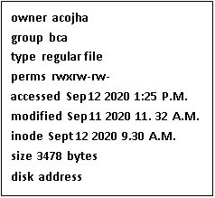
Disk Inode
A disk inode consists of the following fields:
Ownership information: ownership is divided into a user and a group of users. Root user has access to all the files.
File type: whether a file is a normal file, a directory, a device file, or a block or character special file.
File access permissions: there are 3 types of access permissions: owner, group and others. Read, write, execute
Access times: the times at which the file was last accessed and last modified, and the time at which the inode was last modified
Number of links: number of places from which the file is being referred.
File size: the addressing of the file begins from location 0 from relative to the starting location and the size of the file is the maximum offset of the file + 1. For example, if a user creates a file and writes a byte at offset 999, the size of the file is 1000.
Disk address: a table of contents or an array of disk blocks on which the data is scattered.
The contents of an inode change when changing the contents of a file or when changing its owner, permission, or link settings. Changing the contents of a file automatically implies a change to the inode, but changing the inode does not imply that the contents of the file change.

Slide 5
In-core Inode
The in-core inode contains the following fields in addition to the fields of the disk inode:
Status of the in-core inode, indicating whether
The inode is Locked (it prevents other processes from accessing the inode).
A process is (or many processes are) waiting for it to be unlocked.
The data in the in-core inode differs from the disk inode due to change in the inode data.
The data in the in-core file differs from the disk copy due to change in the file data.
The file is a mount point.
The logical device number of the file system that contains the file.
The inode number. (Since inodes are stored in a linear array on disk, the kernel identifies the number of a disk inode by its position in the array. The disk inode does not need this field.)
Pointers to other in-core inodes.
A reference count, indicating the number of instances of the file that are active (such as when the file is opened).

Slide 6
Structure of a Regular File
In UNIX, the data in files is not stored sequentially on disk blocks. Because, when files grow or sink, it creates disk fragmentation.
The kernel could minimize fragmentation of storage space by periodically running garbage collection procedures to compact available storage, but that would cost additional processing power.
Therefore contiguous memory allocation is not a better memory allocation strategy.
For greater flexibility, the kernel allocates file space one block at a time and allows the data in a file to be spread in non-contiguous blocks in the disk. But this allocation scheme complicates the task of locating the data.

Slide 7
Disk address in inode
The table of contents of disk address in inode could consist of a list of block numbers that contain the data belonging to the file.
But simple calculations show that a linear list of file blocks in the inode is difficult to manage.
If a logical block contains 1K bytes, then a file consisting of 10K bytes would require an index of 10 block numbers, but a file containing 100K bytes would require an index of 100 block numbers.
Either the size of the inode would vary according to the size of the file, or a relatively low limit would have to be placed on the size of a file.
To keep the inode structure small, yet still allow large files, the System V UNIX system runs with 13 entries in the inode table of contents for disk blocks and use both direct and indirect addressing.

Slide 8
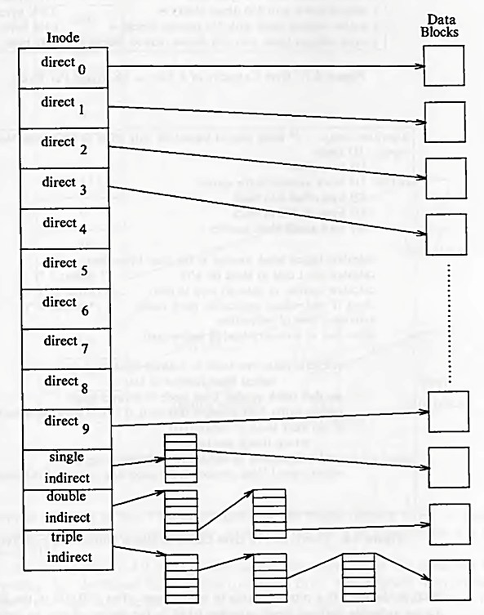
Direct and Indirect Blocks in Inode table of contents
The first 10 entries of the array are "direct addresses", meaning that they contain the numbers of disk blocks that contain real data.
The 11th entry is "single indirect", it stores the block number of the block which has "direct addresses".
The 12th entry is "double indirect", it stores block number of a "single indirect" block.
The 13th entry is "triple indirect", it stores block number of a "double indirect" block.
This strategy can be extended to "quadruple" or "quintuple" indirect addressing.

Slide 9
File Size
Assume that a logical block on the file system holds 1K bytes and that a block number is addressable by a 32 bit (4 byte) integer. Then a block can hold up to 256 block numbers.
The maximum file size with 13 member data array is: The maximum number of bytes that could be held in a file is calculated at well over 16 gigabytes, using 10 direct blocks and 1 single indirect, 1 double indirect, and 1 triple indirect block in the inode.
10 direct blocks with 1K bytes each = 10K bytes
1 indirect block with 256 direct blocks = 256K bytes
1 double indirect block with 256 indirect blocks = 64M bytes (i.e. 256 *256 = 65536)
1 triple indirect block with 256 double indirect blocks = 16G bytes (i.e. 256*256*256=16777216)

Slide 10
Converting Logical Byte Offset of a File to a Physical Disk Block
Processes access data in a file by byte offset (byte position starting from 0).
They work in terms of byte counts and view a file as a stream of bytes starting at byte address 0 and going up to the size of the file.
The kernel accesses the inode and converts the logical file block into the appropriate disk block.
Consider two examples for converting a file byte offset into a physical disk block. Assume that a disk block contains 1024 bytes (1K bytes) and a block can hold up to 256 block numbers.

Slide 11
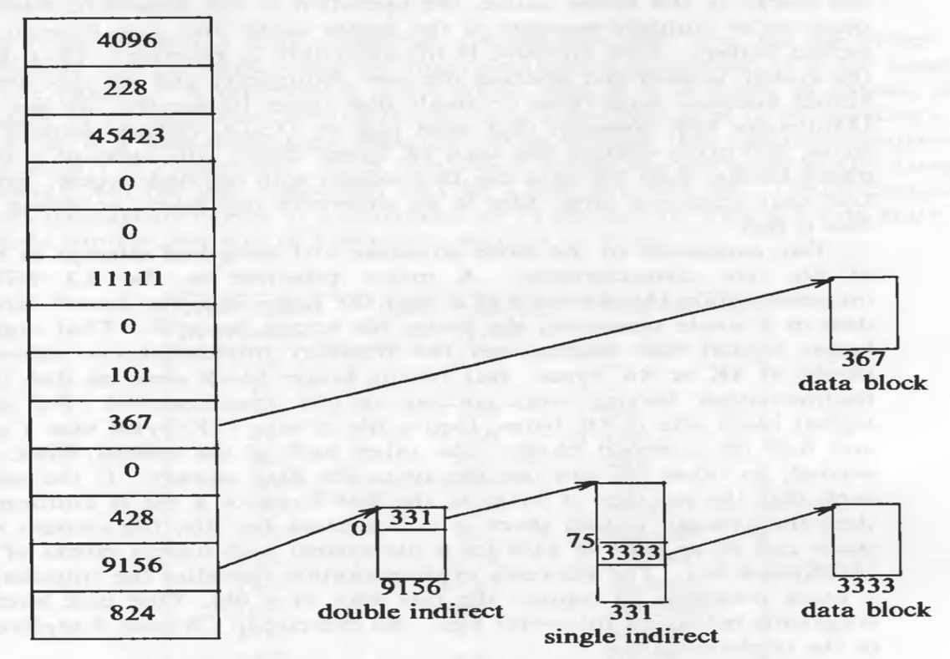
Illustrations
To access byte offset 9000: The first 10 blocks contain 10K bytes. So 9000 should be in the first 10 block. 9000 / 1024 = 8 so it is in the 8th block (starting from 0). And 9000 % 1024 = 808 so the byte offset into the 8th block is 808 bytes (starting from 0). (say block 367 in the figure)
To access byte offset 350000: The first 10 blocks contain 10K bytes (350000 - 10240 = 339760). A single indirect block contains 256K bytes. (339760 - (256 * 1024) = 77616). So a double indirect block (block 9156 in the figure) must be used.
Every single indirect block in the double indirect block contains 256K (256 * 1024 = 262144), so data must be in the 0th single indirect block (say block 331 in the figure).
Every direct block in the single indirect block contains 1K bytes. So the data must be in 75th (77616 / 1024 = 75) (starting from 0) direct block (say block number 3333 in the figure). And the byte offset will be 77616 % 1024 = 816. (77616-(1024*75)=816)

Slide 12

THANK YOU Any questions…?

